Slide 1
Generative AI and LLM

Slide 2
LLMs are a type of generative AI technology that have gained significant attention in recent years. Similar to other general-purpose technologies like deep learning and electricity, LLMs have the potential to impact a wide range of applications across various industries. These models are trained on massive amounts of data, enabling them to generate human-like text and carry out complex tasks with remarkable accuracy.

Slide 3
Text Generation before LLMs
The development of generative algorithms has been a continuous journey, with earlier iterations relying on recurrent neural networks (RNNs). While RNNs were groundbreaking at the time, they faced limitations due to the computational and memory requirements needed for effective generative tasks. A simple example of an RNN attempting to predict the next word illustrates these challenges. Even when scaled to consider more preceding words, the model still falls short in making accurate predictions. The reason lies in the complexity of language itself.

Slide 4
However, in 2017, everything changed with the introduction of the transformer architecture, as described in the influential paper titled “Attention is All You Need” by Google and the University of Toronto. The transformer revolutionized generative AI by enabling efficient scaling on multi-core GPUs, parallel processing of input data, and harnessing larger training datasets. Its key breakthrough was the ability to learn and utilize attention mechanisms, allowing the model to focus on the meaning of the words being processed. This transformative approach demonstrated that attention is indeed the key ingredient needed for significant advancements in generative AI.

Slide 5
Transformers architecture
The transformer architecture revolutionized natural language tasks and propelled language models to new heights of performance. One of its key strengths lies in self-attention, which enables the model to understand the relevance and context of every word in a sentence. By assigning attention weights to the relationships between words, regardless of their position, the model gains a comprehensive understanding of language. This is depicted in an attention map, where connections between words are highlighted.

Slide 6
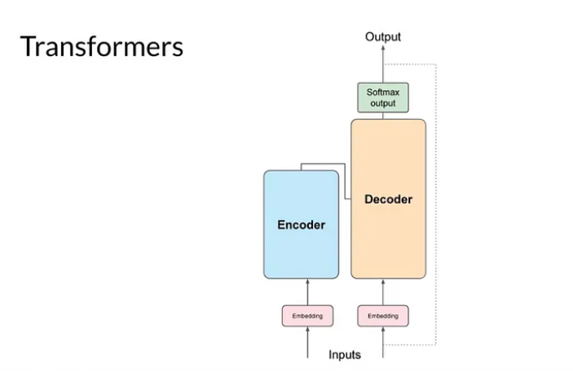
Main components are encode, decoder

Slide 7
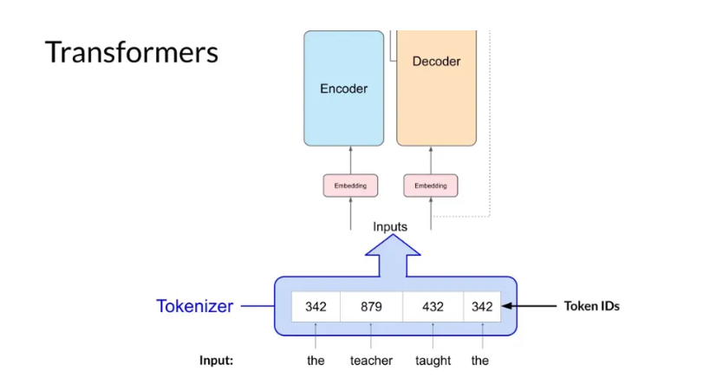
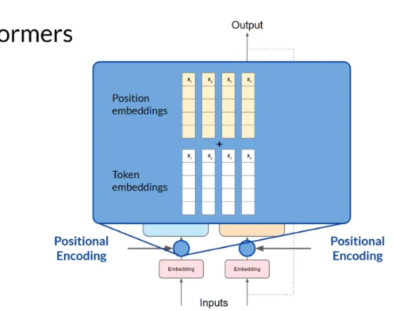
However, before feeding text into the model, words need to be tokenized and converted into numerical representations using a tokenizer. This allows the model to work with numbers rather than words. The embedding layer then maps these token IDs to high-dimensional vectors, encoding the meaning and context of each token. These vectors occupy a unique location in the embedding space, facilitating mathematical understanding of language.
Additionally, positional encoding is added to preserve word order information. The input tokens, along with positional encodings, are passed to the self-attention layer, where the model analyzes relationships between them. Multiple sets of self-attention weights, known as attention heads, are learned in parallel, capturing different aspects of language.
The output of self-attention is processed through a feed-forward network, resulting in logits proportional to the probability scores for each token.

Slide 8
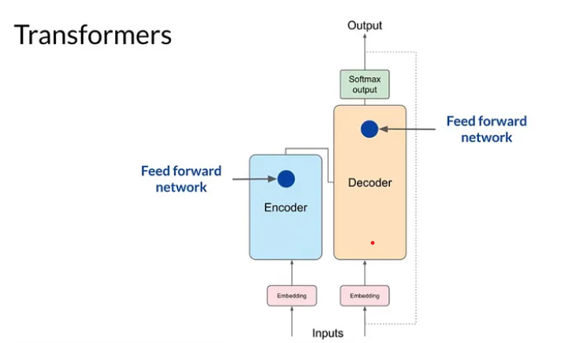
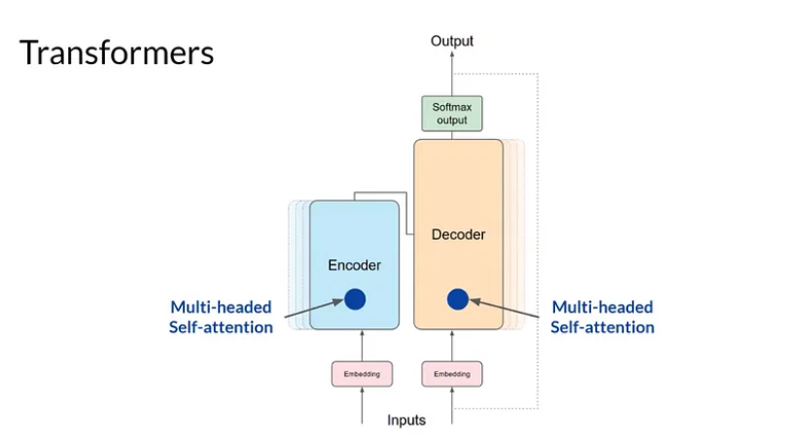
Softmax normalization produces a probability score for every word in the vocabulary. The most likely predicted token is determined from this probability vector, with various methods available for selection.

Slide 9
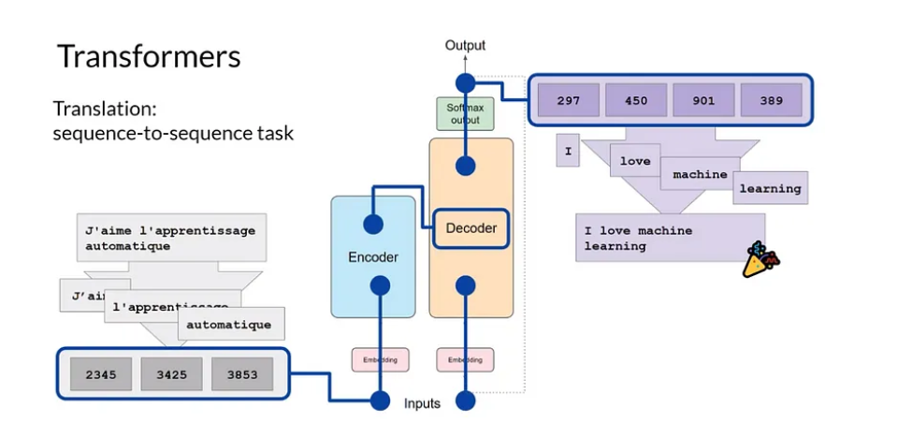
Generating text with transformers
The transformer architecture revolutionized the field of natural language processing with its encoder-decoder framework. In this architecture, the encoder processes input sequences, embedding them and passing them through multi-headed attention layers. This results in a deep representation of the input’s structure and meaning. The decoder, on the other hand, utilizes the encoder’s contextual understanding, starting with a start-of-sequence token, to generate new tokens in a loop. This generation continues until an end-of-sequence token is predicted, producing the final output sequence. While the encoder-decoder model is commonly used for sequence-to-sequence tasks like translation, variations exist.

Slide 10
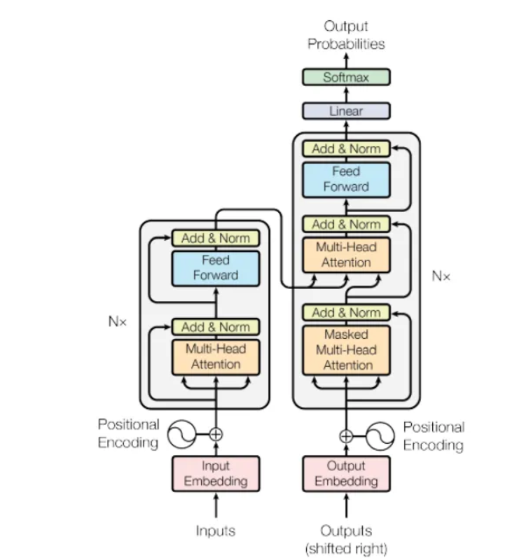
The Transformer architecture consists of an encoder and a decoder, each of which is composed of several layers. Each layer consists of two sub-layers: a multi-head self-attention mechanism and a feed-forward neural network. The multi-head self-attention mechanism allows the model to attend to different parts of the input sequence, while the feed-forward network applies a point-wise fully connected layer to each position separately and identically.
The Transformer model also uses residual connections and layer normalization to facilitate training and prevent overfitting. In addition, a positional encoding scheme is introduced that encodes the position of each token in the input sequence, enabling the model to capture the order of the sequence without the need for recurrent or convolutional operations.

Slide 11
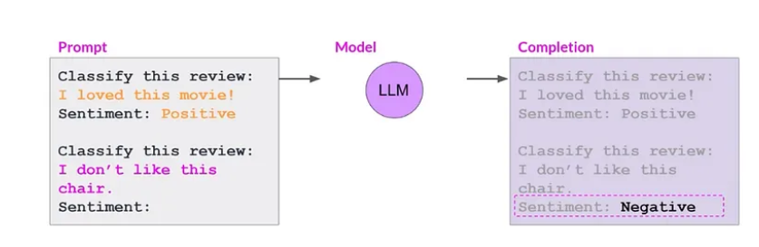
Prompting and prompt engineering
One-shot inference involves providing a single example within the prompt to guide the model’s understanding. This can enhance performance, especially for smaller models. Few-shot inference takes this concept further by including multiple examples, enabling the model to learn from a diverse set of instances. By leveraging these examples, models gain a clearer understanding of the desired behavior and produce more accurate completions.

Slide 12
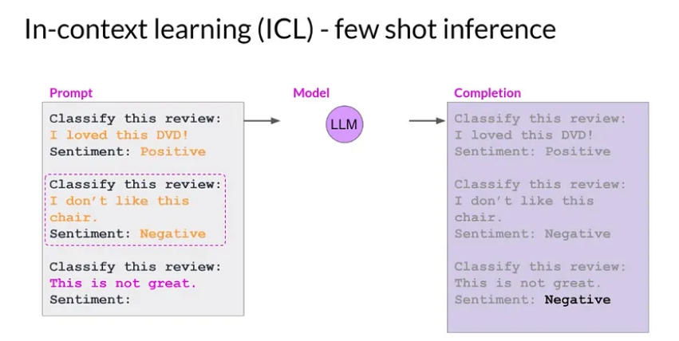
Few shot

